Slide 1


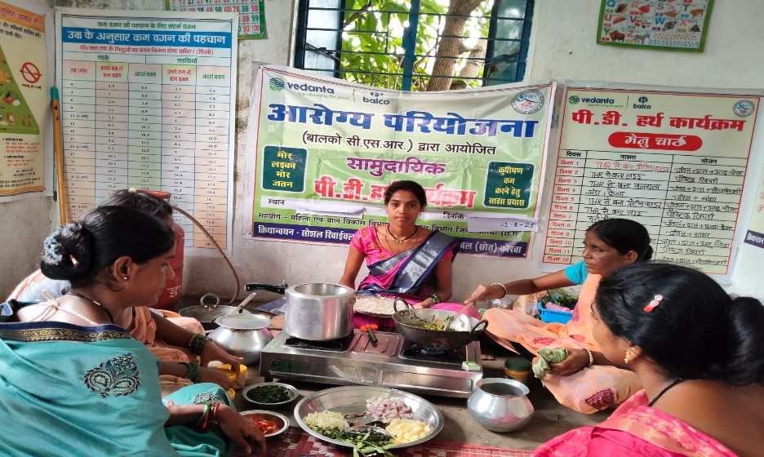
BHARAT ALUMINIUM COMPANY LIMITED (BALCO)
Positive Deviance/Hearth (PDH)
Implementing Agency - Social Revival Group of Urban Rural and Tribal (SROUT)

Slide 2
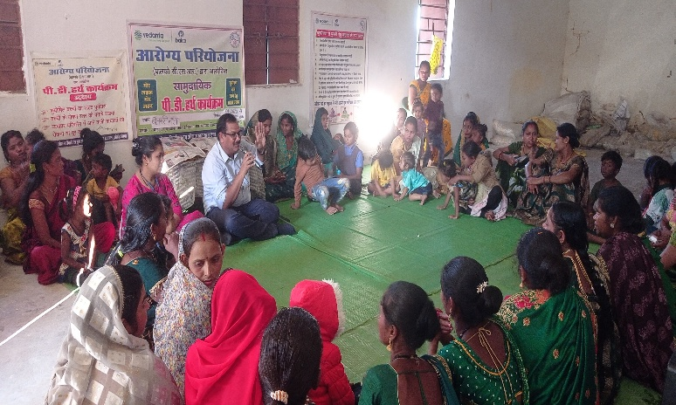
INDEX
Introduction PDH Programme
Implementation Methodology
PD Hearth Model Steps
Outcomes & Impact of PD Hearth
Innovative aspect of the PD Hearth programme
Case Story- Kunal’s, Avya, Vanisha & Vanessa Health Journey
Thanks
Schedule for 12 Days PDH
PDH Programme Food Chart

Slide 3
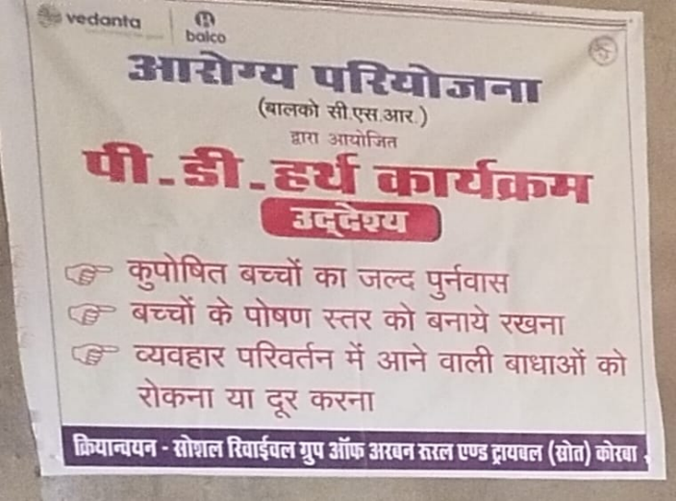
Project Innovation Models
PD Hearth Model
Introduction:. Positive Deviance/Hearth (PDH) is a behavior change program
used to rehabilitate underweight and wasted children without medical
complications; sustain their rehabilitation; and prevent future malnutrition.
Malnourished children are fed a nutrient-dense meal during the session that
is provided and cooked by the primary caregivers using low cost, local ingredients.
The Hearth sessions are followed by 1-2 days/week of home follow-up visits for 4-8
weeks to help overcome barriers caregivers may face in practicing the new positive
behaviors at home.
Model Goal: To improve the nutritional status of children 0-59 months of age in the targeted community by
increased screening coverage, early detection and referral, and rapid rehabilitation using a food-based and
behavioral change approach.
Impact: Reduction in prevalence of underweight among under 5 years children
Outcomes: Improved behaviors around child feeding, hygiene, caring, and health-seeking practices. Improved
knowledge and confidence around child feeding, hygiene, caring, and health-seeking practices.

Slide 4
Project Innovation Models
Implementation Methodology
Identifying Malnourishment
Treating Malnourishment
Tracking & Follow up
Strengthening local health bodies
Community Assessment & Sensitization
Dispeling Myths on Malnourishment through FGD, Transect Walk
Development of Nutrition Rich Menu- Urban/ Rural
Health Screenings (0-5Yrs) for identifying Malnourishment (SAM & MAM). Referral services to NRC.
Capacitating on health status identification, Cooking Nutrient rich meals (Low cost, local ingredients ) & caregiving practices.
Local health bodies MAS & VHSNC, AWW’s & ASHA workers trained.
Positive Deviance Hearth
Behavior modification programme (12 Day)
Health Assessment
Target group
Approach
Follow-up
Sustenance
Identified MAM children, SAM (Non eligible for NRC) Primary Caregivers (Mothers)
Post Health screenings
& Home visit follow ups (60 days)
Supplementary Programs & Primary Healthcare Services
Redefining recipes from THR & development of Nutrition gardens for value added Nutrition
3 Rural Health Posts, Campaigns- Poshan Maah etc.
*SAM – Severe Acute Malnourished *MAS – Mahila Arogya Samiti *VHSNC – Village Health Sanitation
and Nutrition Committee *THR -Take Home Ration * NRC- Nutrition Rehabilitation Center

Slide 5
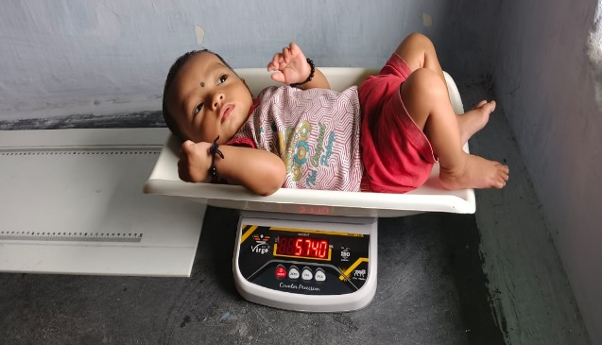
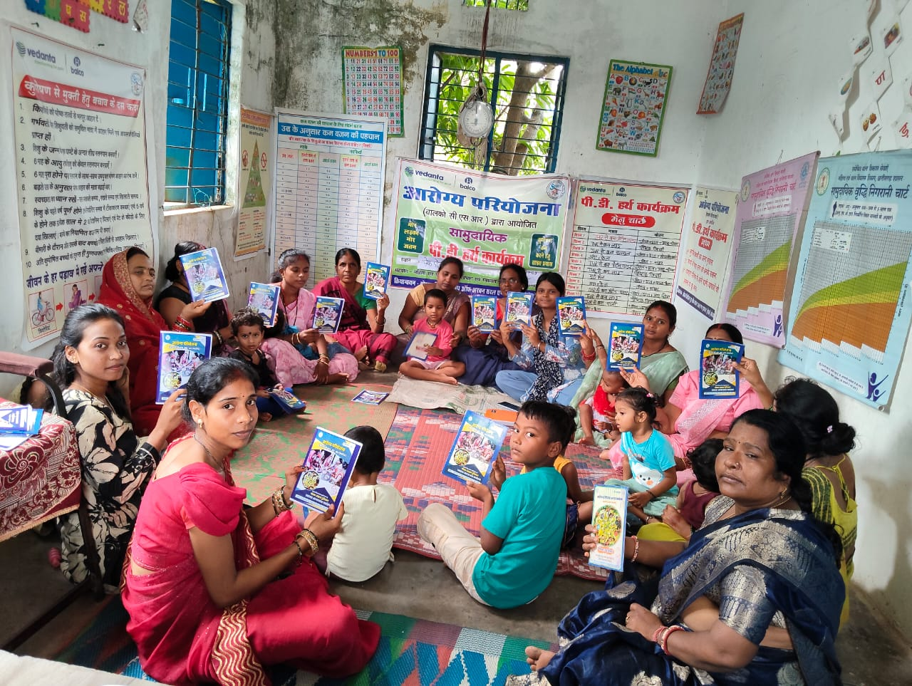
SCREENING OF AWC (6 to 59 month) CHILDREN
NRC REFERRAL
SAM CHILD
FGD WITH COMMUNITY WEALTH RANKING
SEASONAL CALENDAR
TRANSIT WALK HOME VISIT OBSEVRATION
MARKET SURVEY
RESOURCE MAPPING
12 DAYS PDH SESSIONS
THR RECIPIE
NUTRITION DEMO
HEALTH MESSAGES
INITIAL MEETING WITH COMMUNITY
FOLLOW UP 30, 45, 60 DAYS
PD HEARTH MODEL STEPS
Greater success rate
Rehabilitation, Sustain and Adoption
Effective learnings mechnaism
Acceptance from communities
HIGHLIGHTS
Appreciation and acknowledgement by stakeholders
Community involvement/Contributions
Convergence with ICDS
Strengthened bonding with communities

Slide 6
Schedule for 12 Days PDH
Day | Session Topic | Key Information
1St Day | Discussion on child’s weight and general talk
2nd Day | Growth and Development | 1. Child’s weight according to age 2. Information on Growth Chart 3. Areas of child development
3rd Day | Malnutrition | 1. What is Malnutrition 2. How children suffer from malnutrition 3. Steps to prevent malnutrition
4th Day | Immunization | 1. What is immunization and its benefits 2. Immunization schedule (when to give, which diseases it prevents)
5th Day | Importance of Micronutrients | 1. Iron 2. Iodine 3. Vitamin A, C
6th Day | Balanced Diet | 1. Balanced/varied meals
Day | Session Topic | Key Information
7th Day | Malnutrition | 1. Revision on malnutrition 2. Malnutrition-based charts/posters
8th Day | Immunization | 1. Review of immunization 2. Games and recreation with mothers
9th Day | Importance of Micronutrients | Review of importance of micronutrients
10th Day | Balanced Diet | Review of balanced diet
11th Day | Growth and Development | Review of growth and development
12th Day | Review | Again: child’s weight, discussion, and conclusion

Slide 7
Food Chart
PDH Programme Food Chart
Days | Breakfast | Meal
Day 1 | Ready-to-Eat Nutritious Powder | Rice + Dal (lentils) + Mashed Potato
Day 2 | Ready-to-Eat Laddu | Nutritious Khichdi
Day 3 | Ready-to-Eat Nutritious Powder | Rice + Dal + Mashed Potato
Day 4 | Ready-to-Eat Laddu | Nutritious Khichdi
Day 5 | Ready-to-Eat Khurmi | Dal, Rice, and Soybean Vegetable
Day 6 | Egg + Banana | Nutritious Sambar, Rice
Day 7 | Ready-to-Eat Khurmi | Dal, Rice, and Soybean Vegetable
Day 8 | Egg + Banana | Nutritious Sambar, Rice
Day 9 | Ready-to-Eat Nutritious Powder | Rice + Dal + Mashed Potato
Day 10 | Ready-to-Eat Laddu | Nutritious Khichdi
Day 11 | Ready-to-Eat Khurmi | Dal, Rice, and Soybean Vegetable
Day 12 | Egg + Banana | Nutritious Sambar, Rice

Slide 8
Innovative aspect of the PD Hearth programme
Health screenings using Anthropometric tools. Digital integration- App
Value Addition in THR (Supplementary Nutrition by Govt) Recipe booklet developed.
Participatory Approach: Developing Champion Mothers & Volunteers.
Innovative Aspects in PD Hearth
Pioneering this practice in the Aspirational District of Korba
Value Additions to Regular Meals
  Inculcating practice of Nutritious evening snacks
  Addition of Moringa leaf & leafy vegetables
  Introduced Sambhar & Soyabean in diets
  Redefining Khichdi with mixed pulses & vegetables
Additions in cooking practices
  Oil Garnish for improved digestion
  Right way of adding salt
  Use of lemon for improved nutrition
  Use of Curry leaves & sesame seeds for Tadka
Synergy & Contribution: with different schemes and project
Counselling of Secondary Caregivers and Newly-wed Couples, Pregnant and Lactating
AWC’s using Kitchen gardens & practices. Experiential learning.
Breastfeeding Practices
Safe Motherhood Practices
Breast Cancer Awareness
*MAS – Mahila Arogya Samiti *VHSNC – Village Health Sanitation and Nutrition Committee *THR -Take Home Ration *MHV- Mobile Health Van
SUSTAINABILITY & SCALABILITY
Health Awareness & Capacity Building of Caregivers
Linkage with government schemes and facilities
Community Contribution & Ownership
Scalability- Cost efficient, & Participatory Practices
Strengthening Local bodies (MAS/VHSNC, AWW’s)

Slide 9
Outcomes & Impact of PD Hearth
FY - 2023 To 2025 Children PDH Status of 86 AWC's
Particulars | Numbers
Eligible for PDH | 1636
Enrolled In PDH | 1389
Actual Beneficiary of PDH | 1302
Improved Their Health status | 1302
Normal | 552
MAM | 592
SAM | 158
  PD Hearth has shown great positive effect in reducing Malnourishment. Significant movement of kids from SAM to MAM category.
SAM to SAM | SAM to MAM | MAM to MAM | MAM to Normal | Total
46% | 54% | 36% | 64%

Slide 10
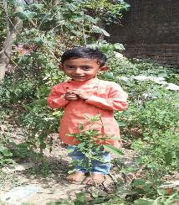
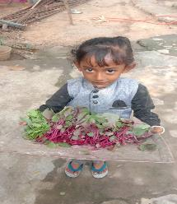
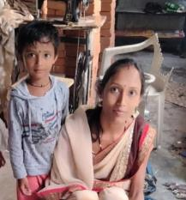
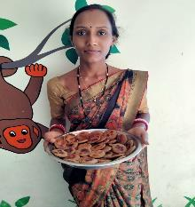
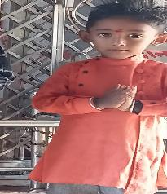
Case Story- Kunal’s Health Journey
Through health screenings Kunal was identified as SAM (Severe Acute Malnourished) category as 8.7 Kg in May 2022
She participate in the THR training and learned 3-4 nutritious recipes. In the month of July, he moved from SAM to MAM. (8.7 kg to 9.3 kg)
Kunal is able to sustain the weight gain. Mamta is actively caring for her child with THR recipes, PDH recipes sustained with Nutrition garden
PDH 12th Day
8.9 Kg
10.2 Kg
11.4 Kg
MAY
JUNE
JULY
SEPTEMBER
SEPTEMBER
Day 45
Day 60
8.7 Kg
9.3 Kg
10.8 Kg
11.5 Kg
Post Identification: Counseling for change in her caring and cooking practices. Provided support for Nutrition garden in order to ensure diversified food is available and given to the child weight
Kunal was enrolled into the PDH session in the month of September. During the 12 days session Kunal gained another 600 grams weight. (Day 1 – 10.2 kg to 10.8 kg)
Kunal After 45 days of PDH the child is now in Normal stage with 11.4 Kg, and he continues to gain good health

Slide 11
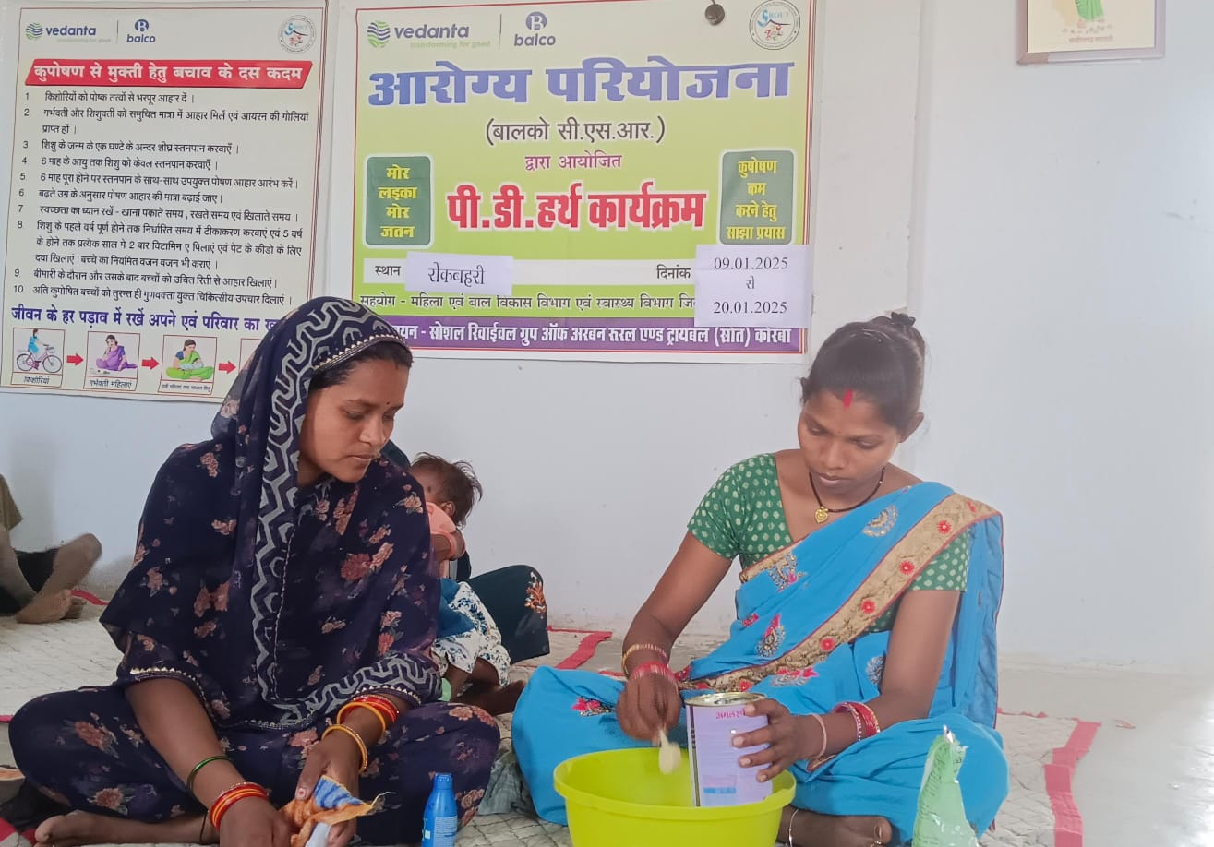
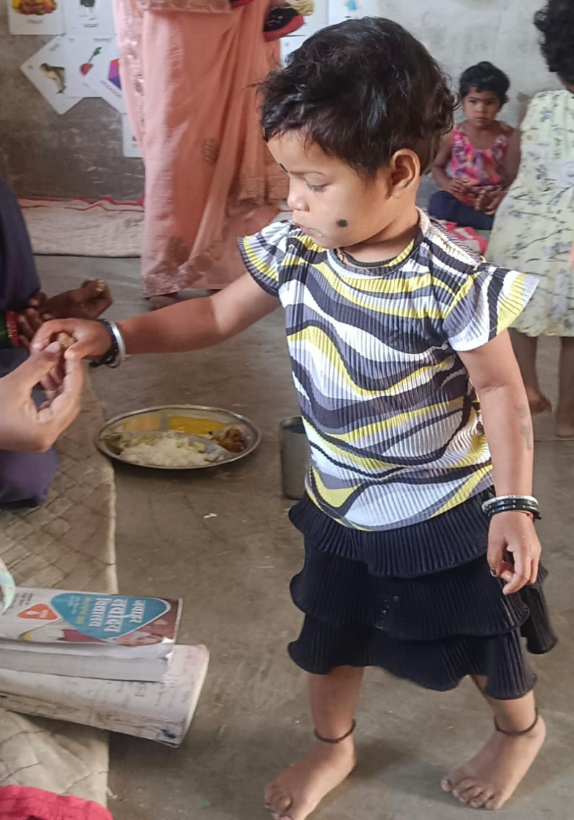
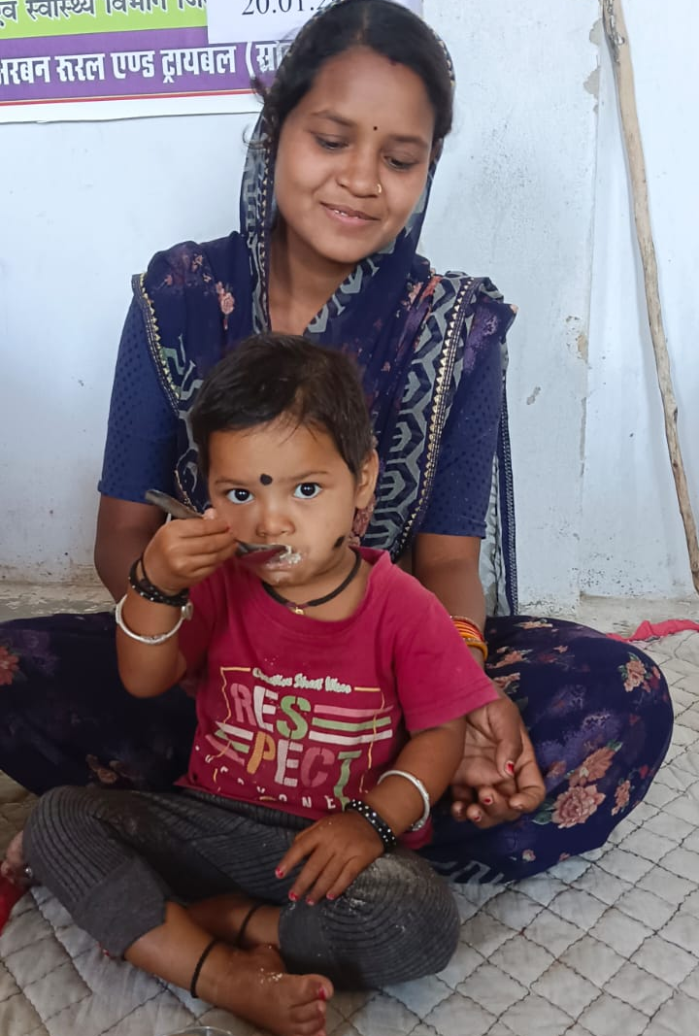
Case Story- Avya Health Journey
Case Story – Avya’s Health Journey
Name: Avya Kanwar
Mother’s Name: Vijay Laxmi Kanwar
Date of Birth: 31/12/2022
  January 2025 Avya was identified as Moderately Acute Malnourished (MAM) during a PDH session at Rokabahri, with a weight of 8.9 kg. Her mother, already engaged in H.B. testing and THR training, received counseling on improved feeding practices.
  PDH Day 12 After 12 days of active participation in the PDH program, Avya gained 600 grams, reaching 9.5 kg. Her mother adopted all the recommended nutritious recipes at home.
February (Day 30) With regular home visits and close monitoring, Avya’s weight increased to 9.9 kg. Her mother continued to follow nutrition guidance diligently.
March (Day 60) By the 60th day, Avya’s weight reached 10.2 kg, moving her into the Normal nutrition category.
Conclusion :- Through consistent support, active participation, and dedicated caregiving, Avya achieved a healthy nutritional status. Her mother’s commitment played a crucial role in this transformation.

Slide 12
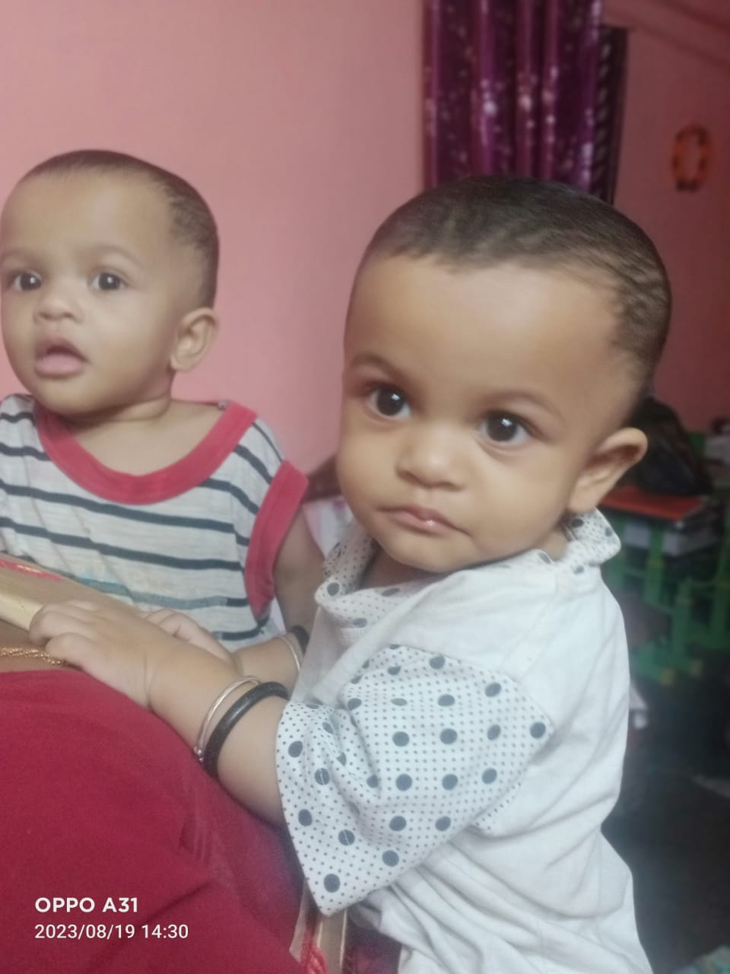
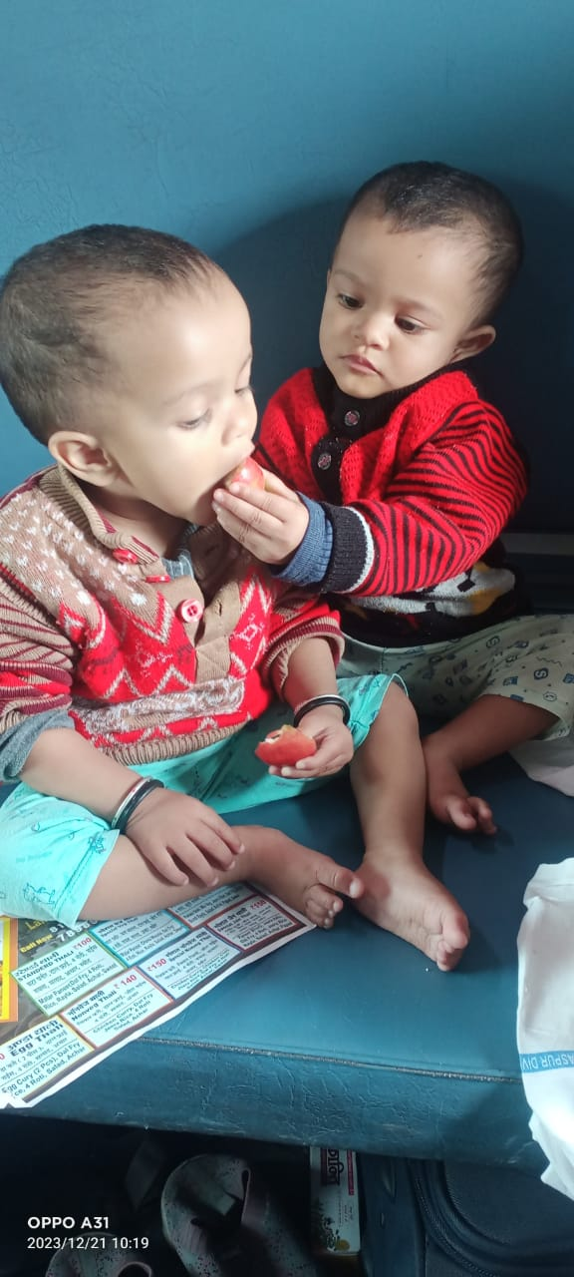
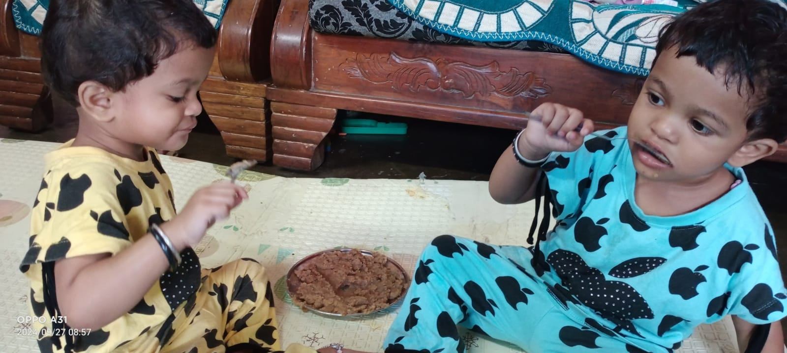
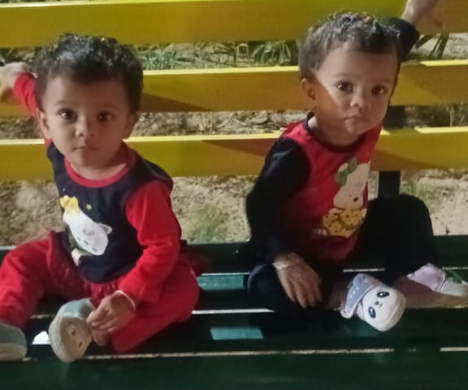
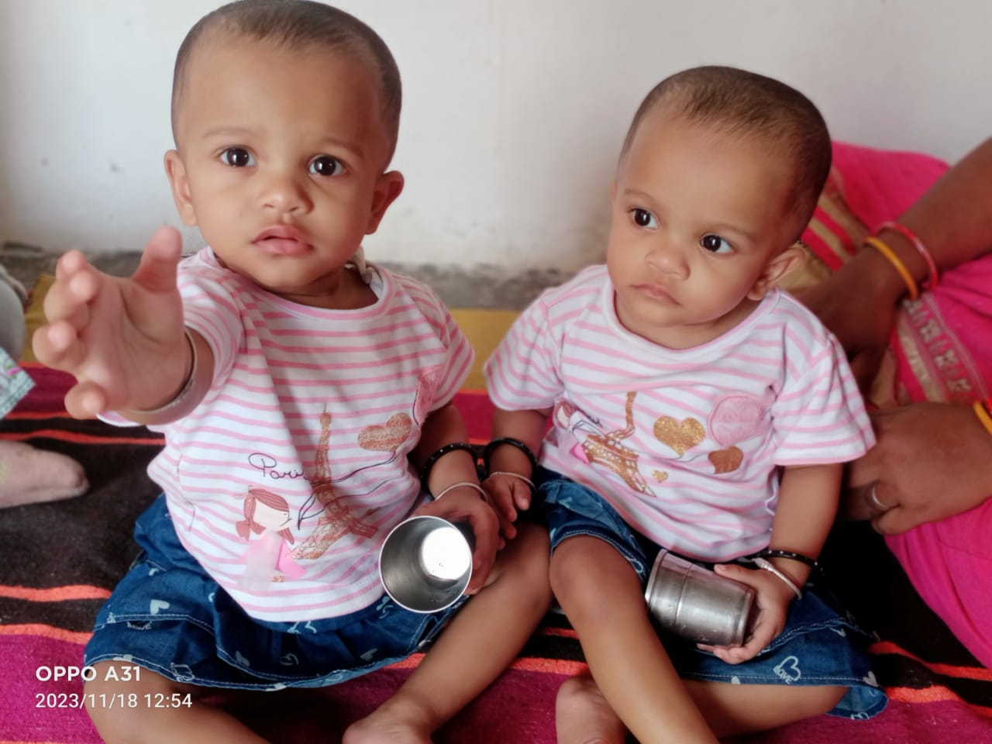
Case Story- Vanisha & Vanessa Health Journey
Through health screenings, Susanna Ji’s twin daughters Vanisha & Vanessa were identified as underweight. Managing the household and caring for three children alone was challenging for her.
Susanna Ji participated in THR training and learned 3-4 nutritious recipes. She followed the guidance consistently, which led to noticeable weight improvement in her twins.
Now, both children continue to maintain a healthy weight of 10.3 kg & 10.7 kg. Susanna Ji’s dedication and efforts paid off, and with continuous guidance and a nutritious diet, her children are growing well.
07 kg & 7.4 kg
Oct
8.05 kg & 9 Kg
July
Sep
Nov
Current Status
8 kg & 8.05 Kg
6.6 kg & 07 kg
10.3 Kg & 10.7 Kg
During a home visit, the Arogya Project team introduced her to the THR Program and PDH Sessions. Despite difficulties, she attended the PDH sessions daily, carrying both daughters
Susanna Ji enrolled her daughters in PDH Sessions. Within 12 days, both children gained weight steadily.

Slide 13
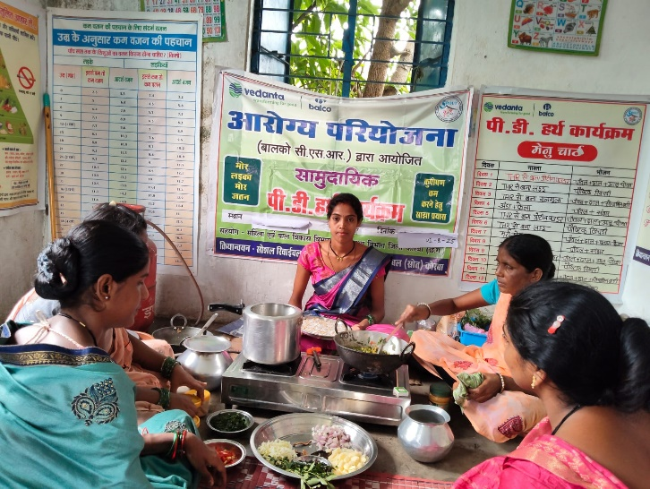
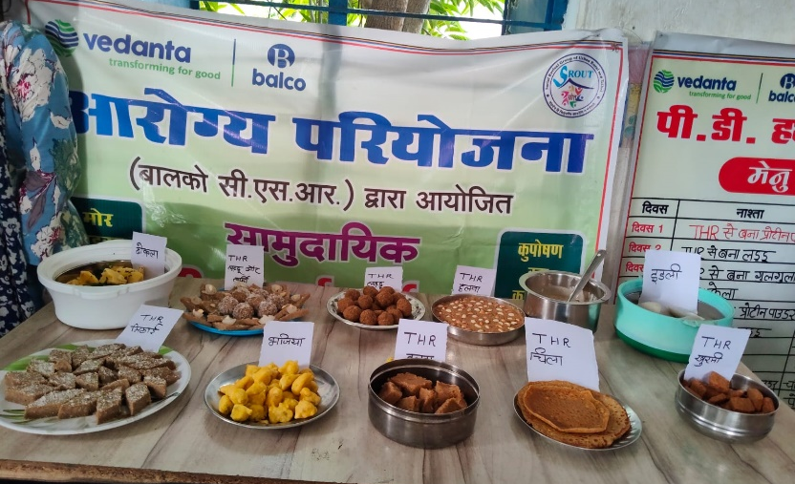
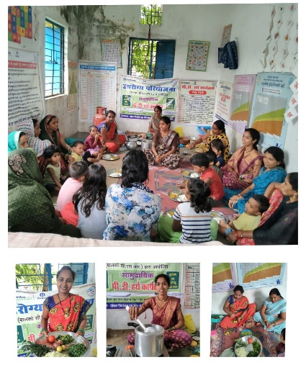
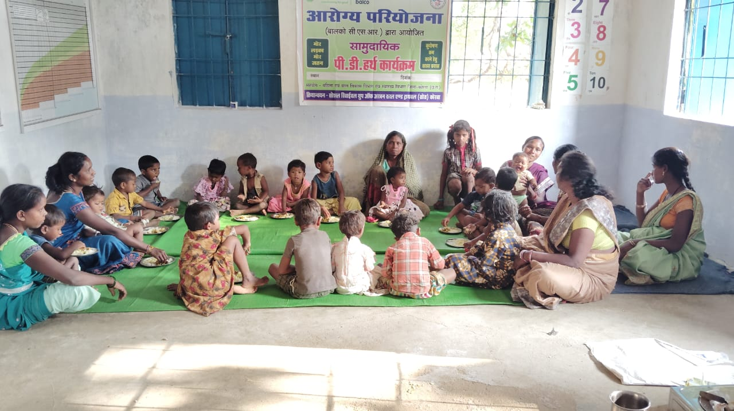
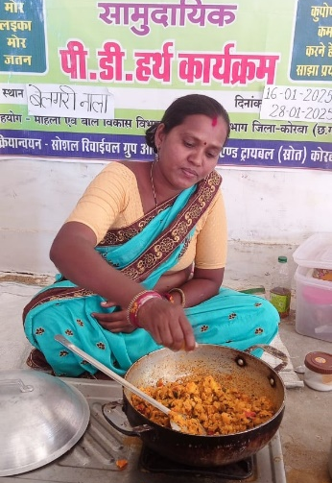
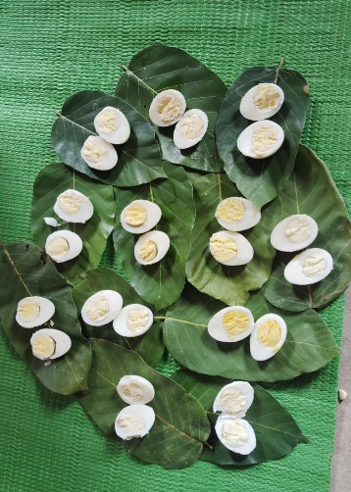
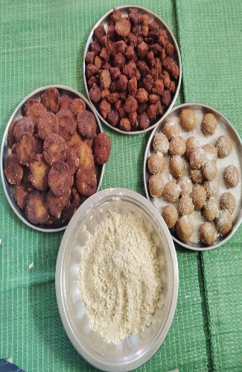
Photo Story-

Slide 14

